Slide 1
Requirements Engineering Processes

Slide 2
Topics covered
Feasibility studies
Requirements elicitation and analysis
Requirements validation
Requirements management

Slide 3
Requirements engineering processes
The processes used for RE vary widely depending on the application domain, the people involved and the organisation developing the requirements.
However, there are a number of generic activities common to all processes
  Requirements elicitation;
  Requirements analysis;
  Requirements validation;
  Requirements management.

Slide 4
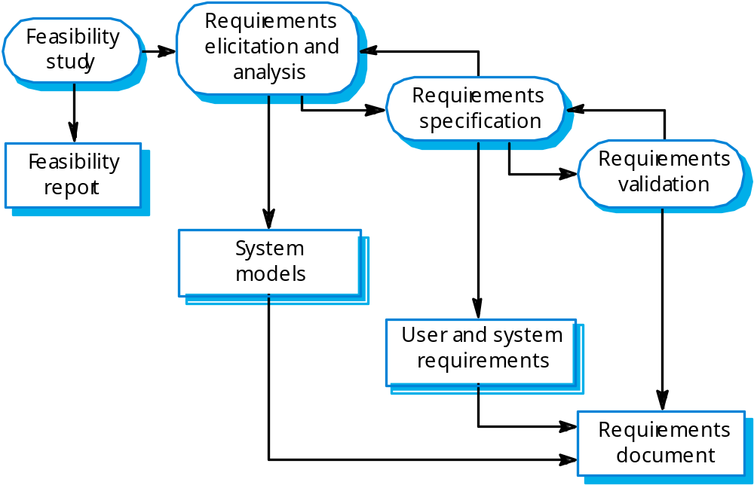
The requirements engineering process

Slide 5
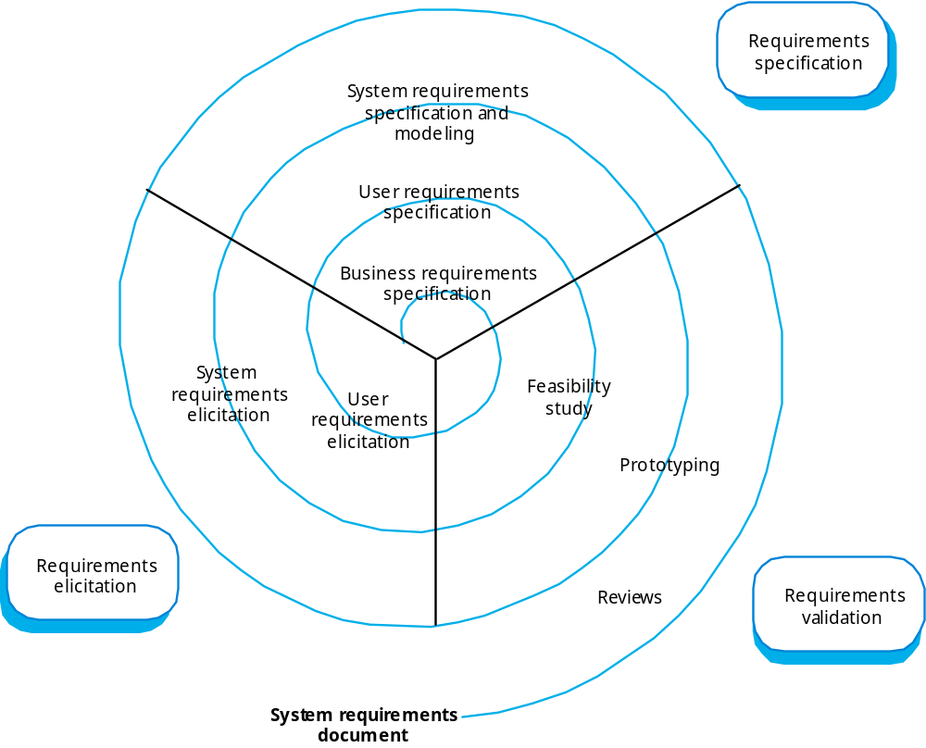
Requirements engineering

Slide 6
Feasibility study implementation
Based on information assessment (what is required), information collection and report writing.
Questions for people in the organisation
  What if the system wasn’t implemented?
  What are current process problems?
  How will the proposed system help?
  What will be the integration problems?
  Is new technology needed? What skills?
  What facilities must be supported by the proposed system?

Slide 7
Elicitation and analysis
Sometimes called requirements elicitation or requirements discovery.
Involves technical staff working with customers to find out about the application domain, the services that the system should provide and the system’s operational constraints.
May involve end-users, managers, engineers involved in maintenance, domain experts, trade unions, etc. These are called stakeholders.

Slide 8
Problems of requirements analysis
Stakeholders don’t know what they really want.
Stakeholders express requirements in their own terms.
Different stakeholders may have conflicting requirements.
Organisational and political factors may influence the system requirements.
The requirements change during the analysis process. New stakeholders may emerge and the business environment change.

Slide 9
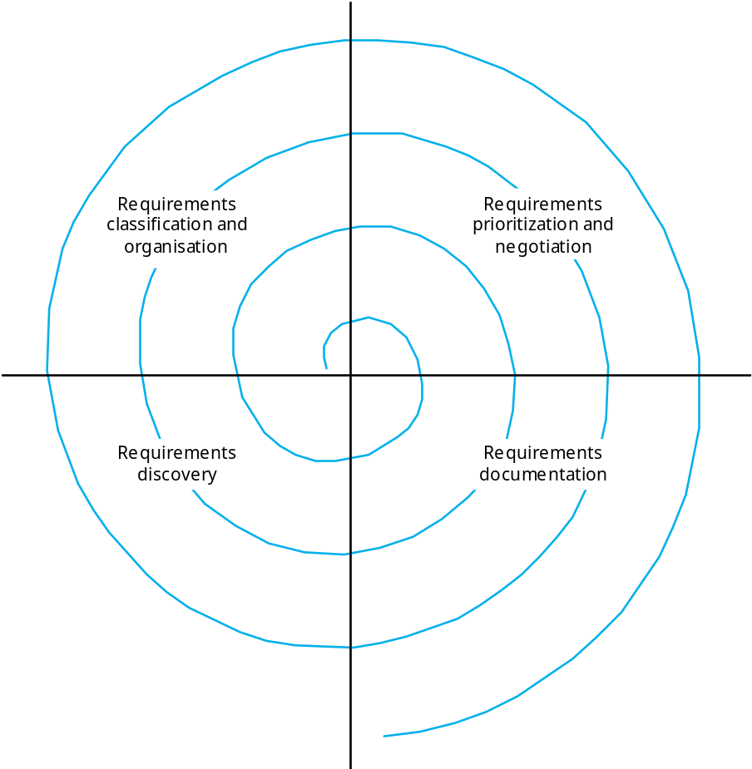
The requirements spiral

Slide 10
Process activities
Requirements discovery
  Interacting with stakeholders to discover their requirements. Domain requirements are also discovered at this stage.
Requirements classification and organisation
  Groups related requirements and organises them into coherent clusters.
Prioritisation and negotiation
  Prioritising requirements and resolving requirements conflicts.
Requirements documentation
  Requirements are documented and input into the next round of the spiral.

Slide 11
Interviewing
In formal or informal interviewing, the RE team puts questions to stakeholders about the system that they use and the system to be developed.
There are two types of interview
  Closed interviews where a pre-defined set of questions are answered.
  Open interviews where there is no pre-defined agenda and a range of issues are explored with stakeholders.

Slide 12
Interviews in practice
Normally a mix of closed and open-ended interviewing.
Interviews are good for getting an overall understanding of what stakeholders do and how they might interact with the system.
Interviews are not good for understanding domain requirements
  Requirements engineers cannot understand specific domain terminology;
  Some domain knowledge is so familiar that people find it hard to articulate or think that it isn’t worth articulating.

Slide 13
Effective interviewers
Interviewers should be open-minded, willing to listen to stakeholders and should not have pre-conceived ideas about the requirements.
They should prompt the interviewee with a question or a proposal and should not simply expect them to respond to a question such as ‘what do you want’.

Slide 14
Scenarios
Scenarios are real-life examples of how a system can be used.
They should include
  A description of the starting situation;
  A description of the normal flow of events;
  A description of what can go wrong;
  Information about other concurrent activities;
  A description of the state when the scenario finishes.

Slide 15
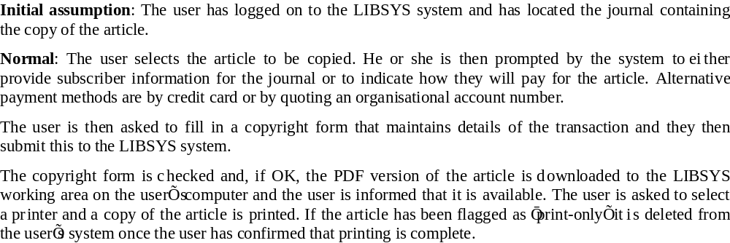
LIBSYS scenario (1)

Slide 16
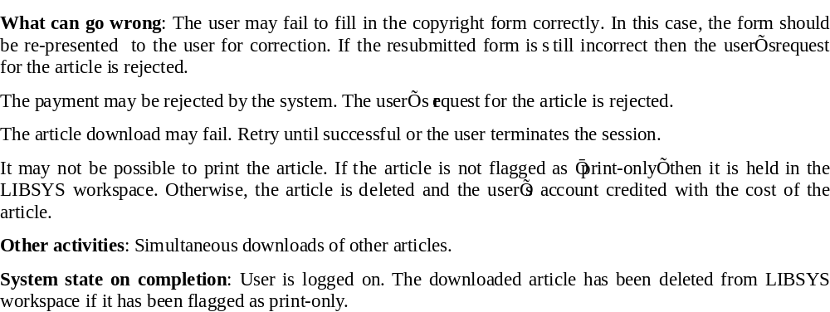
LIBSYS scenario (2)

Slide 17
Use cases
Use-cases are scenario based technique in the UML which identify the actors and interactions with in a scenario.
A set of use cases should describe all possible interactions with the system.
Sequence diagrams may be used to add detail to use-cases by showing the sequence of event processing in the system.

Slide 18
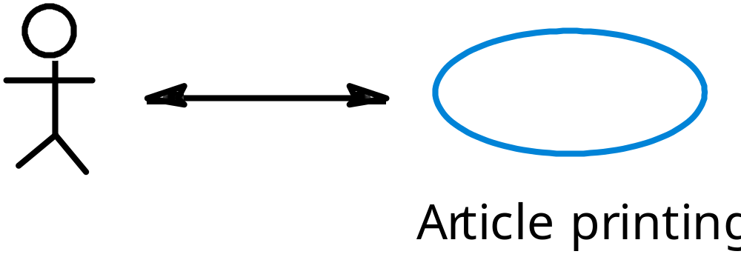
Article printing use-case

Slide 19
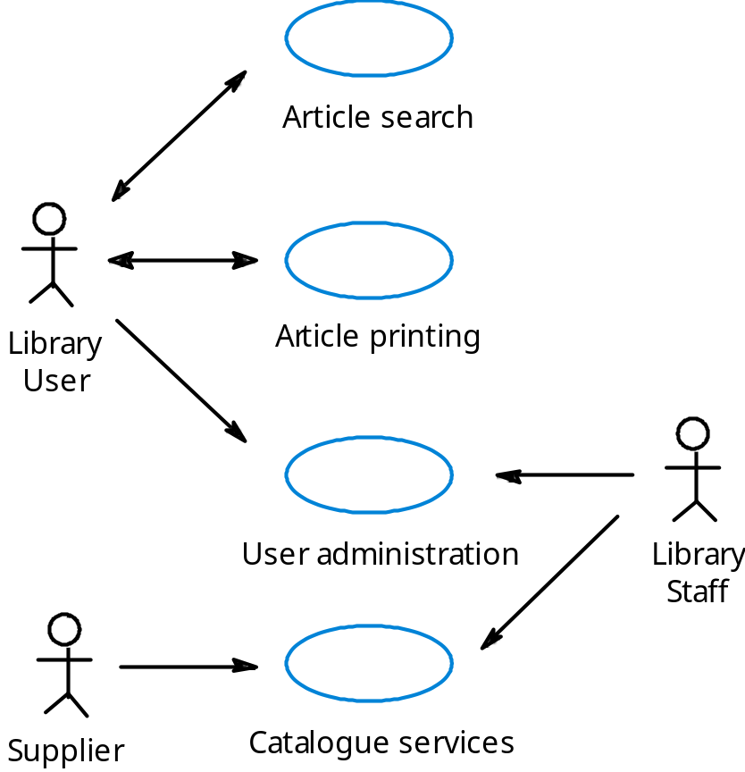
LIBSYS use cases

Slide 20
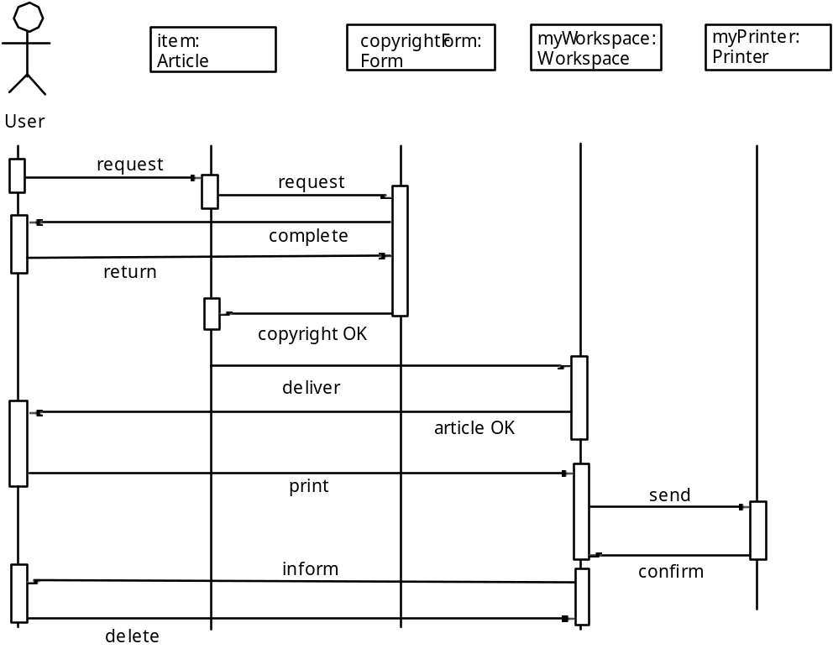
Article printing

Slide 21
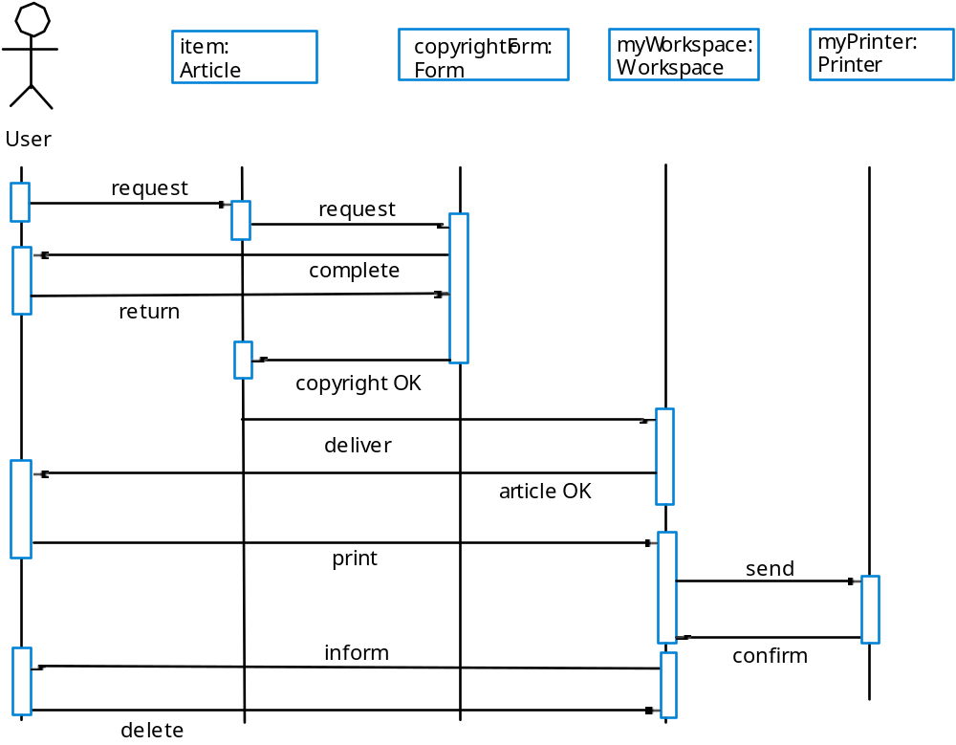
Print article sequence

Slide 22
Requirements checking
Validity. Does the system provide the functions which best support the customer’s needs?
Consistency. Are there any requirements conflicts?
Completeness. Are all functions required by the customer included?
Realism. Can the requirements be implemented given available budget and technology
Verifiability. Can the requirements be checked?

Slide 23
Requirements validation techniques
Requirements reviews
  Systematic manual analysis of the requirements.
Prototyping
  Using an executable model of the system to check requirements. Covered in Chapter 17.
Test-case generation
  Developing tests for requirements to check testability, such as, User Acceptance Test (UAT) requirement.

Slide 24
Requirements reviews
Regular reviews should be held while the requirements definition is being formulated.
Both client and contractor staff should be involved in reviews.
Reviews may be formal (with completed documents) or informal. Good communications between developers, customers and users can resolve problems at an early stage.

Slide 25
Review checks
Verifiability. Is the requirement realistically testable?
Comprehensibility. Is the requirement properly understood?
Traceability. Is the origin of the requirement clearly stated?
Adaptability. Can the requirement be changed without a large impact on other requirements?

Slide 26
Requirements management
Requirements management is the process of managing changing requirements during the requirements engineering process and system development.
Requirements are inevitably incomplete and inconsistent
  New requirements emerge during the process as business needs change and a better understanding of the system is developed;
  Different viewpoints have different requirements and these are often contradictory.

Slide 27
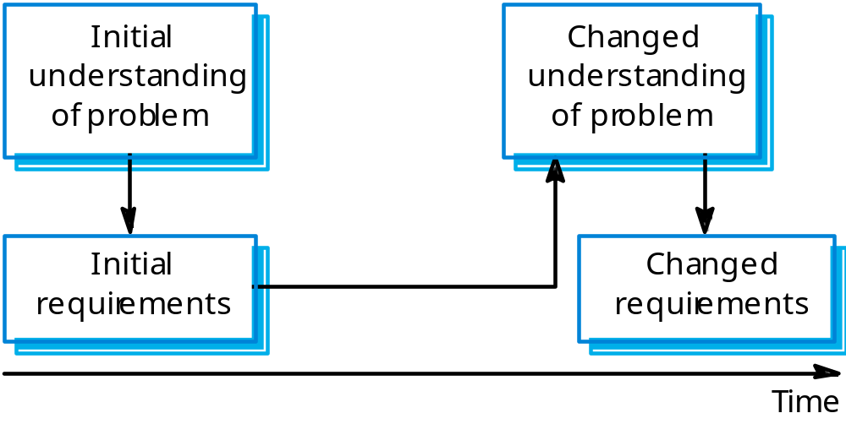
Requirements evolution

Slide 28
Requirements change management
Should apply to all proposed changes to the requirements.
Principal stages
  Problem analysis. Discuss requirements problem and propose change;
  Change analysis and costing. Assess effects of change on other requirements;
  Change implementation. Modify requirements document and other documents to reflect change.

Slide 29
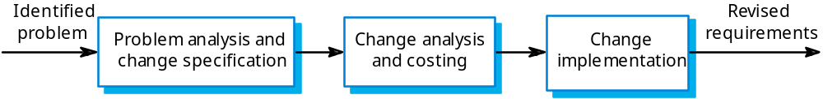
Change management

Slide 30
Key points
The requirements engineering process includes a feasibility study, requirements elicitation and analysis, requirements specification and requirements management.
Requirements elicitation and analysis is iterative involving domain understanding, requirements collection, classification, structuring, prioritisation and validation.
Systems have multiple stakeholders with different requirements.

Slide 31
Key points
Social and organisation factors influence system requirements.
Requirements validation is concerned with checks for validity, consistency, completeness, realism and verifiability.
Business changes inevitably lead to changing requirements.
Requirements management includes planning and change management.

